Slide 1


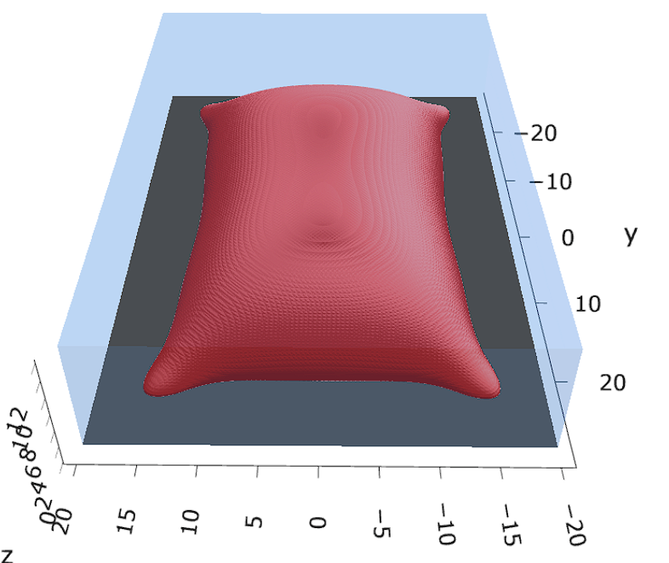
a00s3e3
Terran
F = -1.77893

Slide 2










a00s5e3
F = -2.986
F = -2.98574
F = -2.98732
F = -2.98580
F = -2.98637
F = -2.98644

Slide 3
a00s7e3
Terran found stripes → holes?
Terran found holes unstable?
-4.20224

Slide 4
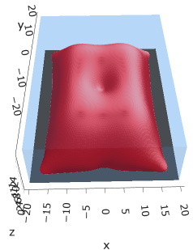



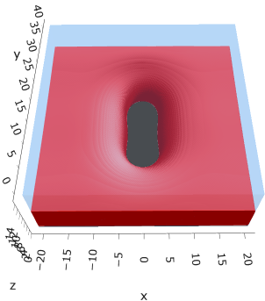
a10s5e3
F = -2.93788
F = -2.93788

Slide 5
a20s025

Slide 6
a15

Slide 7
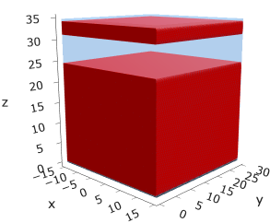
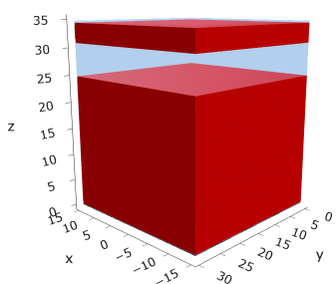
a25
s15
s18

Slide 8





a35
s10
s12
s15
s18

Slide 9



Parallelization
$$α=0, χ=1.25, N=50, σ=0.02$$
$$α=0, χ=1.25, N=200, σ=0.005$$
$$L_{x}=L_{y}=23, { L}_{z}=15$$
Nth = 12: 500 it, 4.3 hrs
Nth = 8 : 500 it, 6.9 hrs
Nth = 6 : 415 it, 20 hrs (poss. mem bottleneck)

Slide 10







Exercise: Micelle / Stripe
s = 5e-03, N = 50, a = 0.0, x = 1.0
s = 5e-03, N = 75, a = 0.0, x = 1.0
Isosurface at pha = 0.1

Slide 11






a040x170s020

Slide 12






a040x170s010

Slide 13

a040x170s025

Slide 14














a040x170s022

Slide 15










a040x170 seed
See if becomes hex
cyl4-975
cyl4-12
cyl16-975
cyl16-1025
cyl1

Slide 16






a040x170s017

Slide 17












































a040x170s015 seed
Almost done
Almost done

Slide 18

















a040x170s013

Slide 19
















a040x170s010 seed

Slide 20














X200 x170 x130 x120 x100
F = −10.24458
F = − 9.14301
F = −11.0057
F = −10.2429
F = −11.0015
F = −9.63949
F = −10.2461
F = −10.9948
F = − 9.63030
F = −10.2431
F = −10.9953

Slide 21





a040x100 relaxation

Slide 22








































a040x100 seed
old
old

Slide 23


a040x120 relaxation
F = −10.24458

Slide 24





































a040x120 seed
cyl16-850
cyl16-825

Slide 25






a040x130 relaxation

Slide 26




a040x170 relaxation
F = −9.10347
1 neck

Slide 27







a040x200 relaxation

Slide 28










a040x200 seed
Note: not completely converged but stopped for resources

Slide 30


a0.40 x1.70

Slide 31





Zhulina JCP 1998
a = 0.01
0.1 mM
1 mM
May need to init using sine
10 mM
25 mM
Zhulina NVT; current GCE runs at Lz = 20

Slide 32

Carrillo Langmuir 2009

Slide 33

Parallelization

Slide 34
Equations
Quenched average, np, A --> \inf ; np/A → \sigma
Discrete Gaussian chain

Slide 35




Scaling (Alexander—de Gennes brush)
V = 4.2; H = 27.5 – 30.5
V = 2; H = 39 – 45.5

Slide 36






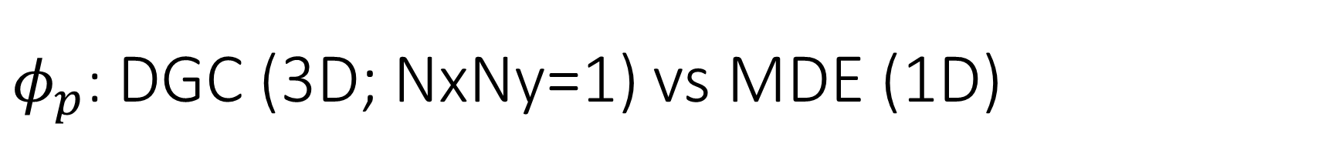
$φ_{p}$: DGC (3D; NxNy=1) vs MDE (1D)
Ns/sigs: dz = 0.10, Ngz_2 = 4$σ$; Chis/bs: dz = 0.25, Ngz_2 = 3.5$σ$

Slide 37


Numericals
Ys
Possibly do Ngz for multiple dzs

Slide 38








3D
Lxy = 1
Lxy = 10
Lxy = 5
Lxy = 15
y-z heatmaps for $φ_{p}$ at constant x

Slide 39





z-FFT vs z-FD (MDE) – REDFT01 xy(z)
Lx = 5, Ly = 5, Lz = 50. s = 0.02. x = 0.75. a = 0.00, N = 50
3D vs 1D (dashed): dz = 0.5, ds = 0.20; dz_1D = 0.113, ds_1D = 0.083
FFT (xyz)
FFT (yz vs pha)
FD (xyz)
FD (yz vs pha)
Diff btw 1D/3D should just be dz, ds, etc.

Slide 40
Specifying Grafted Points

Slide 41
Strategy
2D binary array for surface sites of homogeneously grafted polymer given grafting density, simulation box size, and discretization (and assuming dx = dy)
Fullspace must be periodic on x0 = xL, y0 = yL
Halfspace must be even on xL/2 and yL/2 (overlap of boundary following REDFT00) and periodic on x0 = xL, y0 = yL.
Homogeneous spacing as determined by regular hexagon, where grafting point at centroid of hexagon
In case there are edge effects, try shifting the centroids away from the boundaries of the xy-plane (only did for fullspace)
Make sure no edge effects by comparing results of full FFT with cos FFT

Slide 42
Test conditions
Sigma = 0.05 c/nm2
Lx = 15 nm
Ly = 15 nm
dx = 0.4 nm
Cast in terms of dx (for rounding and PBC for grafting points):
Sigma = 0.0668 c/nm2
Lx = 14.80 nm
Ly = 11.20 nm
(Sigma error decrease with dx)

Slide 43

Padded PBC (Full FFT)
Hexagons drawn for illustration of hexagon approach

Slide 44

Unpadded PBC (Full/Cos FFT)

Slide 45






Other conditions (full and half results overlapped to show match)
s = 0.0241 (20.28%; dx=0.4), Lx, Ly = 12.40, 20.80
s = 0.0208 (4.08%; dx=0.1), Lx, Ly = 12.90, 22.30
s = 0.1332 (11%; dx=0.1), Lx, Ly = 20.50, 20.40

Slide 46


